Slide 1

The Healthy Harvest Sales Analysis

Slide 2
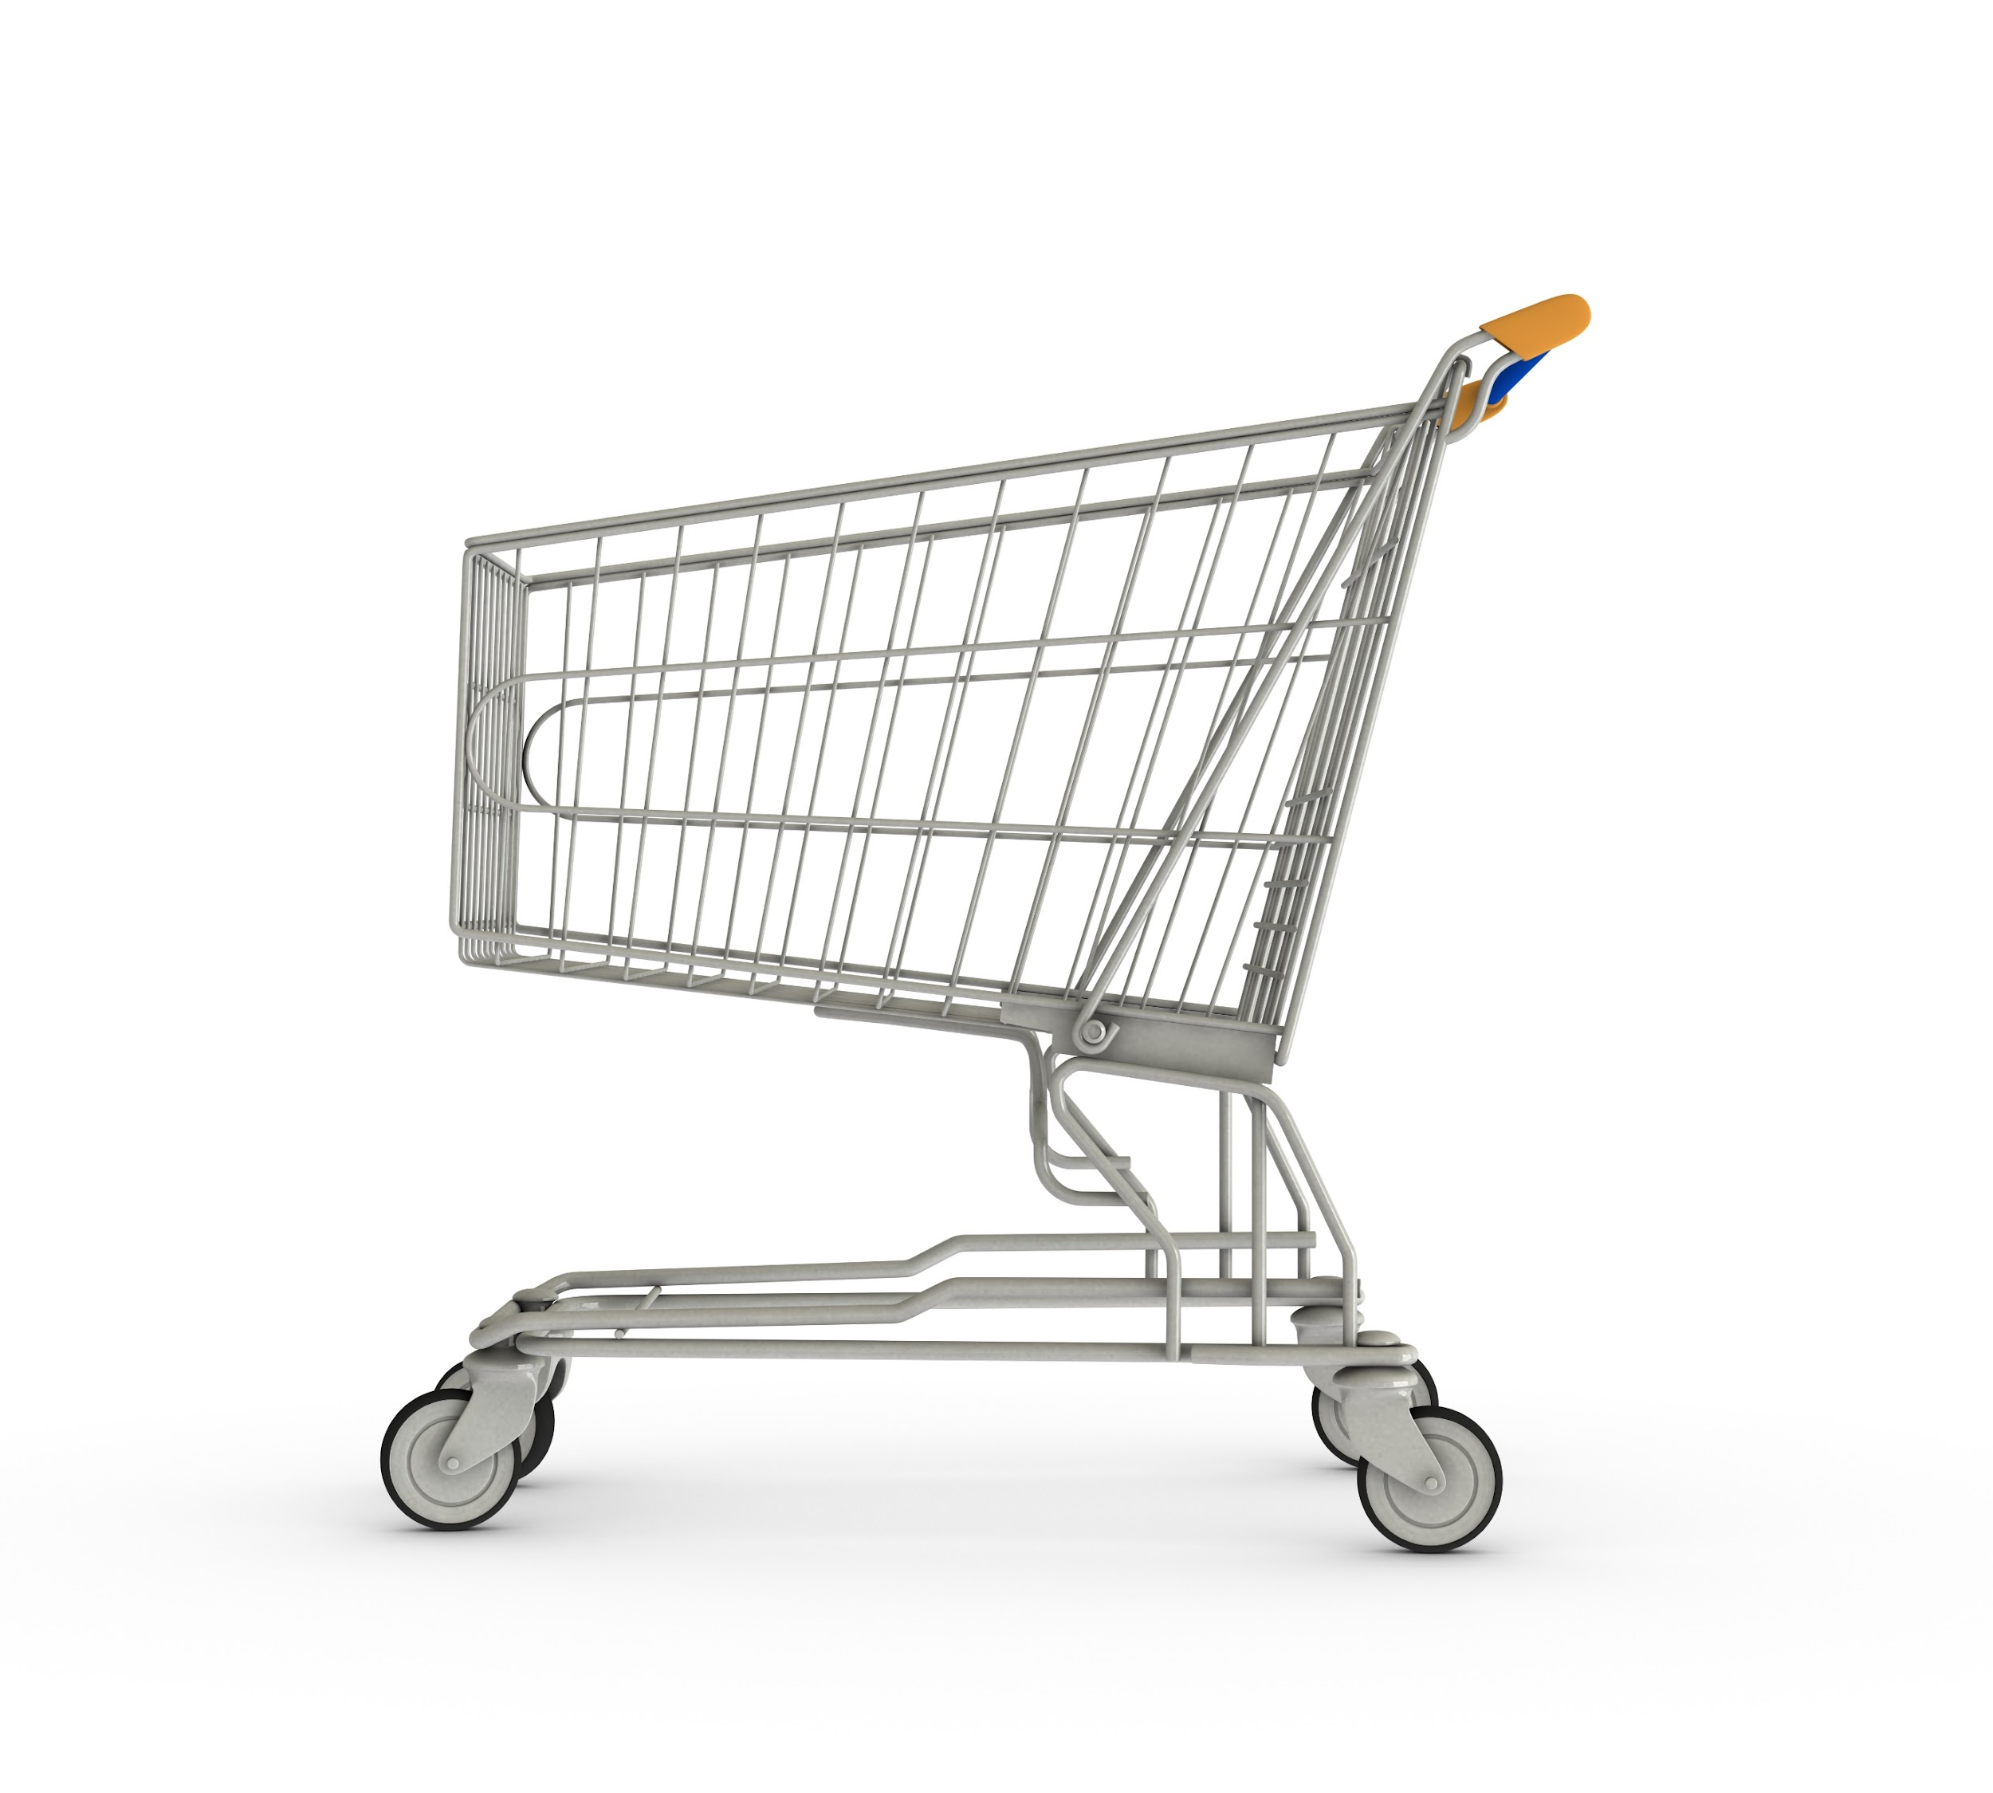
Agenda
1. Project Recap
4. Insights
2. Problems
5 Model Development
3. Analytics Team
6. Summary

Slide 3
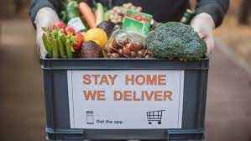
Project Recap
Our client, a major online grocery retailer servicing cities within Tamil Nadu, India. The Healthy harvest has requested that the Resilient Analytics team help analyze their sales data and provide a sales forecast using a machine learning model. They want to be able to increase customer satisfaction by:
Eliminating Overstocking in order to sell fresh products at all times
Accurately forecasting sales to reduce revenue loss due to product understocking during peak periods.

Slide 4
Inaccurate forecast sales.
Stock shortages and overstocking
Revenue loss
Problems

Slide 5
The Analytics Team
Project Management Team
Faith Leo
Joyce Ogabi
Wisdom Ojo
Data Engineers
Olalekan Olujobi
Khadijah Okanlawon
Data Analysts
Omela Okosi
Chinazor Onuorah
Favour Ejimkonye
Machine Learning Engineers
Amos Kiprop
Lateef Azeez
Phoebe Joel

Slide 6

Workflow
Data Collection
and Understanding
Data Engineering
and Cleaning
Insights
Model Development

Slide 7
Insights
23
Products sold across the state
7
Unique Categories
Tasks
24
Cities serviced in Tamil Nadu
Kanyakumari
City with highest sales.
Resources

Slide 8
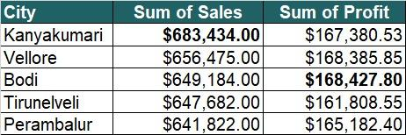
Insights
Tasks
Management Objectives
Resources

Slide 9
Insights
Total Revenue
Total Profit
Management Objectives
$15M
$3.65M
Resources

Slide 10
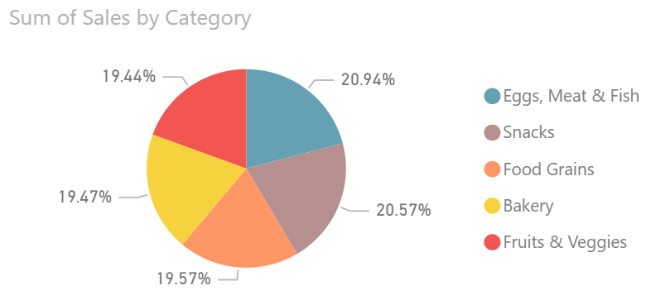

Insights
Total Sales Percentage by Category

Slide 11
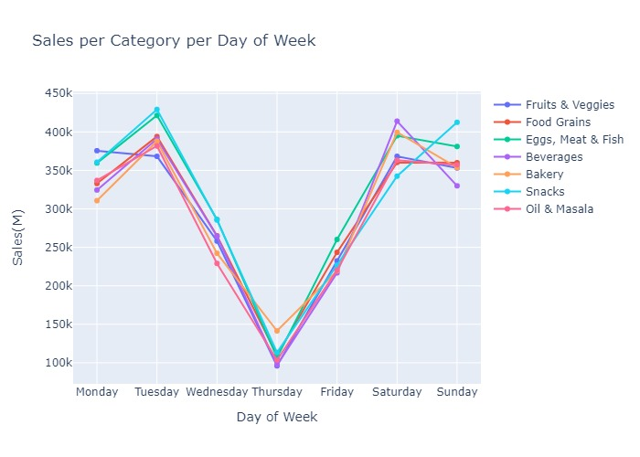
Insights
Sales Per Category Per Day of Week

Slide 12
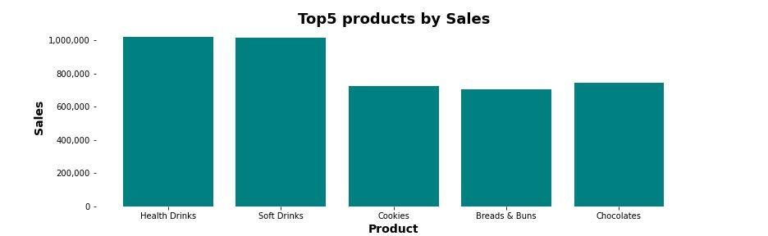
Insights
Top 5 Products by Sales

Slide 13
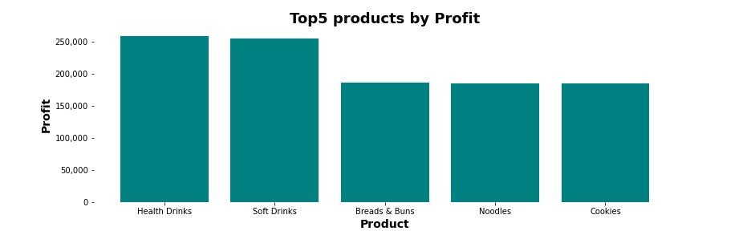
Insights
Top 5 Most Profitable Products

Slide 14
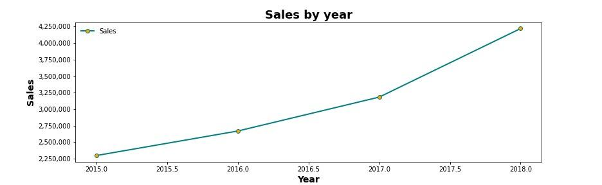
Insights
Sales Trend over the Years

Slide 15
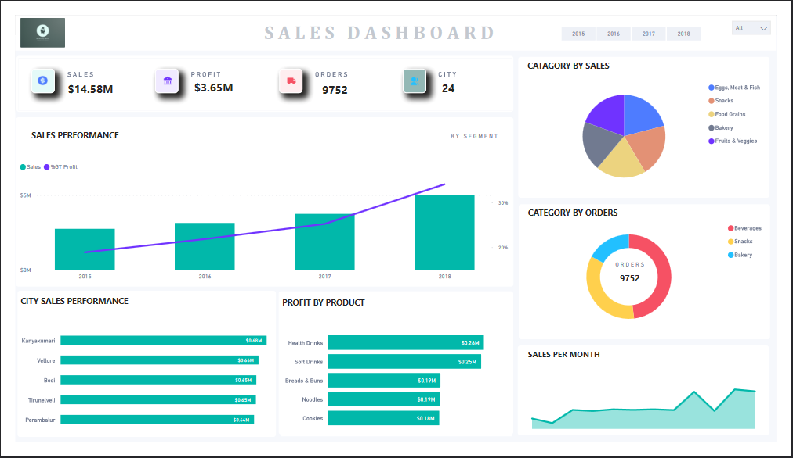

Slide 16
Model Development
Models tested
Linear Regression Model
Arima model
The Linear Regression Model was implemented because it took more features into account and yielded a better result.
The adjusted R-squared value = 0.5248336623113667.
This means that the model is able to explain 52% of the total variation in the data, although this is not a good fit, it can be improved by further optimization and feature engineering.

Slide 17
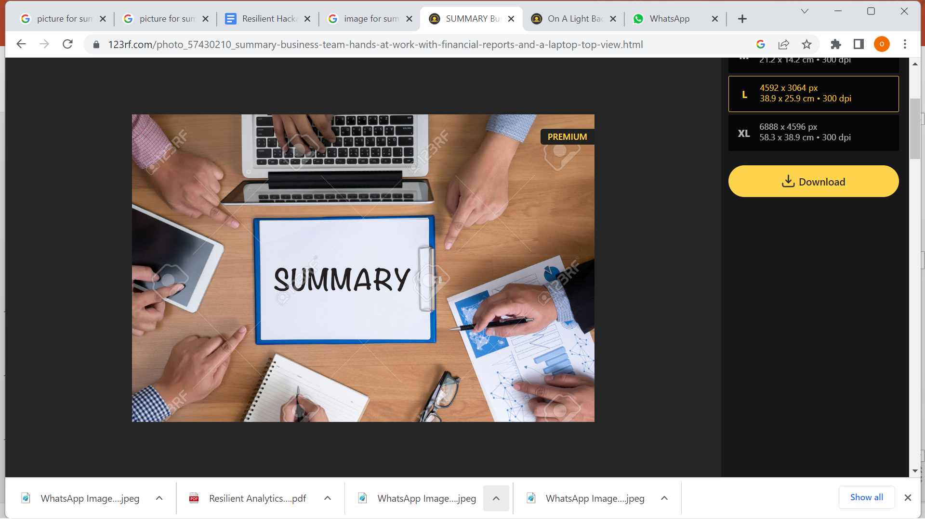
Healthy drinks, Soft drinks, Cookies, Bread & Buns, and Chocolate are the most popular products based on sales, indicating that customers often purchase instant consumables.
On a weekly basis Tuesdays and Saturdays record the highest sales, while Thursdays recorded the lowest sales weekly.
There is a steady growth in revenue year on year. Sales had about an 84% increase from January 2015 to December 2018.

Slide 18
Recommendations
The product stock level should be increased on Tuesdays and Saturdays being the peak sales days and kept minimum on Thursdays being the slowest day.
A marketing campaign focused on instant consumable products to further maximize sales is recommended.

Slide 19
Thank You.
Questions?

